Slide 1
Software Process Models
based on slides of Sommerville
and web sites of XP and Scrum

Slide 2
Resources
Agile Manifesto
agilemanifesto.org
XP
www.extremeprogramming.org
Scrum
www.scrum.org
Many books in the library…

Slide 3
Agile Methodologies
Agile methods are a family of software development processes for teams facing unpredictable or rapidly changing requirements.
Extreme Programming (XP)
Scrum
Agile Modeling
Adaptive Software Development (ASD)
Crystal Clear and Other Crystal Methodologies
Dynamic Systems Development Method (DSDM)
Feature Driven Development
Lean software development
Agile Unified Process (AUP)
(For more detailed information, see The Agile Alliance).
Notes:
Scrum

Slide 4
Rapid software development
Rapid development and delivery is now often the most important requirement for software systems
Businesses operate in a fast –changing requirement and it is practically impossible to produce a set of stable software requirements
Software has to evolve quickly to reflect changing business needs.
By the time the software is available for use, the original reason for its procurement may have changed so radically that the software is effectively useless
Plan-driven development is essential for some types of system but does not meet these business needs.

Slide 5
Till 1990s , the process models were driven by large projects
Driven by a community that develops large software such as aerospace or government systems
For software that has long live
Control software for aircraft
Plan driven, heavy processes
Overhead is justified
Multiple team coordination
Critical system
Long maintenance period, maintained by different people over time
Not suitable for small or medium sized business, the overhead is way to big

Slide 6
Rapid software development
Agile development methods emerged in the late 1990s whose aim was to radically reduce the delivery time for working software systems
to produce useful software quickly.
Specification, design and implementation are inter-leaved
System is developed as a series of versions with stakeholders involved in version evaluation
Frequent delivery of new versions for evaluation

Slide 7
Agile methods
Dissatisfaction with the overheads involved in software design methods of the 1980s and 1990s led to the creation of agile methods. These methods:
Are based on an iterative approach to software development
Are intended to deliver working software quickly and evolve this quickly to meet changing requirements.
The aim of agile methods is to reduce overheads in the software process (e.g. by limiting documentation) and to be able to respond quickly to changing requirements without excessive rework.
Notes:
Focus on the code rather than the design

Slide 8
Agile manifesto
We are uncovering better ways of developing software by doing it and helping others do it. Through this work we have come to value:
Individuals and interactions over processes and tools
Working software over comprehensive documentation
Customer collaboration over contract negotiation
Responding to change over following a plan
That is, while there is value in the items on the right, we value the items on the left more.

Slide 9
What is “Agility”?
Effective (rapid and adaptive) response to change
Effective communication among all stakeholders
Drawing the customer onto the team
Organizing a team so that it is in control of the work performed
Yielding …
Rapid, incremental delivery of software

Slide 10
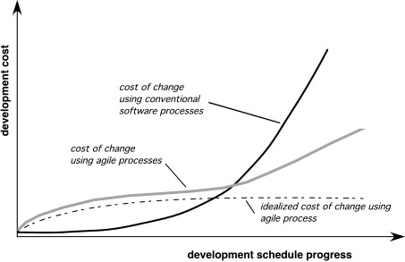
Agility and the Cost of Change

Slide 11
An Agile process
driven by customer descriptions of what is required (scenarios)
Recognizes that plans are short-lived
Develops software iteratively with a heavy emphasis on construction activities
Delivers multiple ‘software increments’
Adapts as changes occur

Slide 12
The principles of agile methods
Principle | Description
Customer involvement | Customers should be closely involved throughout the development process. Their role is provide and prioritize new system requirements and to evaluate the iterations of the system.
Incremental delivery | The software is developed in increments with the customer specifying the requirements to be included in each increment.
People not process | The skills of the development team should be recognized and exploited. Team members should be left to develop their own ways of working without prescriptive processes.
Embrace change | Expect the system requirements to change and so design the system to accommodate these changes.
Maintain simplicity | Focus on simplicity in both the software being developed and in the development process. Wherever possible, actively work to eliminate complexity from the system.

Slide 13
12 principles of Agile
"The highest priority is to satisfy the customer through early and continuous delivery of valuable software.
Welcome changing requirements, even late in development. Agile processes harness change for the customer's competitive advantage.
Deliver working software frequently, from a couple of weeks to a couple of months, with a preference to the shorter time scale.
Business people and developers must work together daily throughout the project.
Build projects around motivated individuals. Give them the environment and support they need, and trust them to get the job done.
The most efficient and effective method of conveying information to and within a development team is face-to-face conversation.
www.agilealliance.org
Notes:
The members of the Agile Alliance declare their manifesto into a collection of twelve principles.

Slide 14
12 principles of Agile
Working software is the primary measure of progress.
Agile processes promote sustainable development. The sponsors, developers, and users should be able to maintain a constant pace indefinitely.
Continuous attention to technical excellence and good design enhances agility.
Simplicity – the art of maximizing the amount of work not done – is essential.
The best architectures, requirements, and designs emerge from self-organizing teams.
At regular intervals, the team reflects on how to become more effective, then tunes and adjusts its behavior accordingly. "
Notes:
The members of the Agile Alliance declare their manifesto into a collection of twelve principles.

Slide 15
agile methods share iterative development's emphasis on building releasable software in short time periods.
Agile methods differ from incremental model
time period is measured in weeks rather than months
treat their time period as strict time box.
work is performed in a highly collaborative manner.
Team: include all the people necessary to finish software
programmers and their customers, testers, interaction designers, technical writers, and managers.

Slide 16
Agile method applicability
Custom system development within an organization, where there is a clear commitment from the customer to become involved in the development process and where there are few external rules and regulations that affect the software.
Agile methods have proved to be successful for small and medium sized projects that can be developed by a small co-located team.

Slide 17
When to apply
In development of complex / innovative products
When you want to avoid big up-front work
When you can work with cross-fucntional teams
When you want to get fequent feedback from your customer/business partner

Slide 18
Problems with agile methods
It can be difficult to keep the interest of customers who are involved in the process.
Customer has to willing to spend time with the development team
Prioritizing changes can be difficult where there are multiple stakeholders.
Team members may be unsuited to the intense involvement that characterizes agile methods.
Maintaining simplicity requires extra work.
Contracts may be a problem as with other approaches to iterative development.
Notes:
Customer involvemenet depends on having a customer who is willing and able to spend time with the development team and who can represent all system stakeholders. Often, customer representatives have other demands on their time and cannot play a full part in the software development.
Where there are external stakeholders, such as regulators, it is difficult to represent their views to the agile team.
Prioritizing changes can be extremely difficult, especially in systems for which there are many stakeholders. Typically, each stakeholder gives different priorities to different changes
Individual team members may not have suitable personalities for the intense involvement that is typical of agile methods, and therefore may not interact well with other team members
Under pressure from delivery schedules, team members may not have time to carry out desirable system simplifications.
Rapid iterations and short-term planning for development does not always fit in with the longer-term planning cycles of business planning and marketing. Marketing managers may need to know what product features several months in advance to prepare an effective marketing campaign.

Slide 19
Agile methods and software maintenance
Most organizations spend more on maintaining existing software than they do on new software development.
So, if agile methods are to be successful, they have to support maintenance as well as original development.
Two key issues:
Are systems that are developed using an agile approach maintainable, given the emphasis in the development process of minimizing formal documentation?
Can agile methods be used effectively for evolving a system in response to customer change requests?
Problems may arise if original development team cannot be maintained.
No documentation, collective knowledge is in the team
How good is the current documentation anyway?
Self documented code

Slide 20
Agile and plan-driven methods
Most projects include elements of plan-driven and agile processes. Deciding on the balance depends on:
Is it important to have a very detailed specification and design before moving to implementation? If so, you probably need to use a plan-driven approach.
Is an incremental delivery strategy, where you deliver the software to customers and get rapid feedback from them, realistic? If so, consider using agile methods.
How large is the system that is being developed? Agile methods are most effective when the system can be developed with a small co-located team who can communicate informally. This may not be possible for large systems that require larger development teams so a plan-driven approach may have to be used. However, there are agile methods for special for big teams

Slide 21
Agile or Plan driven?
Senior developers High requirements change Culture that thrives on chaos
Junior developers Low requirements change Culture that demands order
Agile home ground
Plan-driven home ground
Adapted from Boehm and Turner
Notes:
Boehm and Turner [2] suggest that each side of the continuum has its own home ground. By analyzing the project against these home grounds, the risk of using an agile or plan-driven method can be determined

Slide 22
Plan-driven and agile development
Plan-driven development
A plan-driven approach to software engineering is based around separate development stages with the outputs to be produced at each of these stages planned in advance.
Not necessarily waterfall model – plan-driven, incremental development is possible
Iteration occurs within activities.
Agile development
Specification, design, implementation and testing are inter-leaved
the outputs from the development process are decided through a process of negotiation during the software development process.

Slide 23
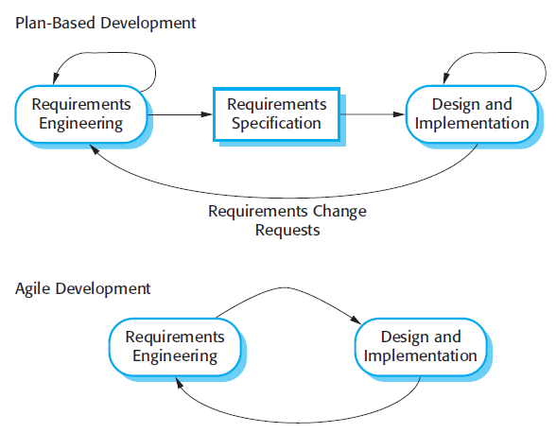
Plan-driven and agile specification

Slide 24
Technical, human, organizational issues
READ THE following 3 SLIDES! They are useful in the midterm
Most projects include elements of plan-driven and agile processes. Deciding on the balance depends on:
Is it important to have a very detailed specification and design before moving to implementation? If so, you probably need to use a plan-driven approach.
Is an incremental delivery strategy, where you deliver the software to customers and get rapid feedback from them, realistic? If so, consider using agile methods.
How large is the system that is being developed? Agile methods are most effective when the system can be developed with a small co-located team who can communicate informally. This may not be possible for large systems that require larger development teams so a plan-driven approach may have to be used.

Slide 25
Technical, human, organizational issues
What type of system is being developed?
Plan-driven approaches may be required for systems that require a lot of analysis before implementation (e.g. real-time system with complex timing requirements).
What is the expected system lifetime?
Long-lifetime systems may require more design documentation to communicate the original intentions of the system developers to the support team.
What technologies are available to support system development?
Agile methods rely on good tools to keep track of an evolving design
How is the development team organized?
If the development team is distributed or if part of the development is being outsourced, then you may need to develop design documents to communicate across the development teams.
Notes:
If you are developing a system using an IDE that does not have good tools for program visualization and analysis, then more design documentation may be required

Slide 26
Technical, human, organizational issues
Are there cultural or organizational issues that may affect the system development?
Traditional engineering organizations have a culture of plan-based development, as this is the norm in engineering. (extensive docum)
How good are the designers and programmers in the development team?
agile methods require higher skill levels than plan-based approaches where programmers simply translate a detailed design into code.
Is the system subject to external regulation?
If a system has to be approved by an external regulator then you will probably be required to produce detailed documentation as part of the system safety case.

Slide 28
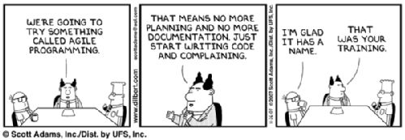
http://blogs.warwick.ac.uk/steverumsby/entry/agile_programming/

Slide 29
Extreme programming
Perhaps the best-known and most widely used agile method.
Extreme Programming (XP) takes an ‘extreme’ approach to iterative development.
New versions may be built several times per day;
Increments are delivered to customers every 2 weeks;
All tests must be run for every build and the build is only accepted if tests run successfully.

Slide 30
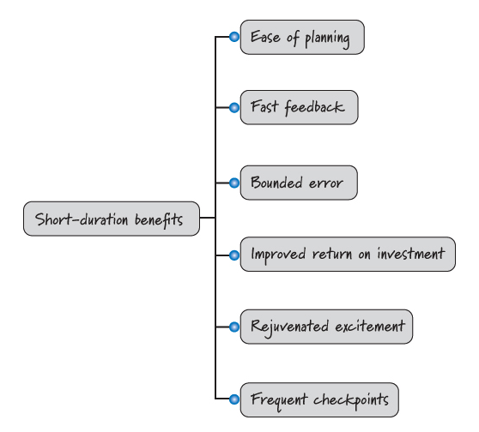
Benefits of Short Duration

Slide 31
XP and agile principles
Incremental development is supported through small, frequent system releases.
Customer involvement means full-time customer engagement with the team.
Responsible for defining acceptance tests
People not process through pair programming, collective ownership and a process that avoids long working hours.
Change supported through regular system releases.
And continuous integration, test first
Maintaining simplicity through constant refactoring of code.

Slide 32
XP and change
Conventional wisdom in software engineering is to design for change. It is worth spending time and effort anticipating changes as this reduces costs later in the life cycle.
XP, however, maintains that this is not worthwhile as changes cannot be reliably anticipated.
Rather, it proposes constant code improvement (refactoring) to make changes easier when they have to be implemented.
the XP approach accepts that changes will happen and reorganize the software when these changes actually occur
Reject the notion that we should design for future change
don’t “borrow trouble” of future

Slide 33
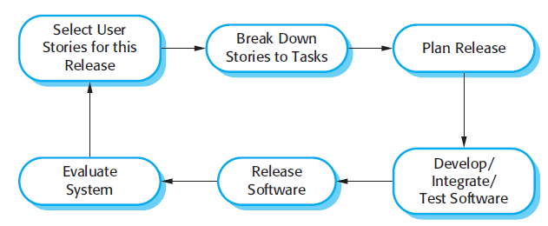
The extreme programming release cycle
User story= req
Programmers work in pairs
develop tests for each task before writing the code.
All tests must be successfully executed when new code is integrated into the system.
There is a short time gap between 2 releases of the system.

Slide 34
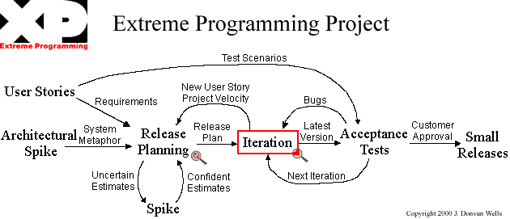
XP Planning
Begins with the creation of “user stories”
Agile team assesses each story and assigns a cost
Stories are grouped to for a deliverable iteration
Make frequent small releases.
A commitment is made on delivery date
After the first increment “project velocity” is used to help define subsequent delivery dates for other iterations
Iteration planning starts each iteration.

Slide 35
Extreme Programming (XP)
XP Design
Follows the KIS (keep it simple) principle
Encourage the use of CRC cards
For difficult design problems, suggests the creation of “spike solutions”—a design prototype
Encourages “refactoring”—an iterative refinement of the internal program design
No functionality is added early.

Slide 36
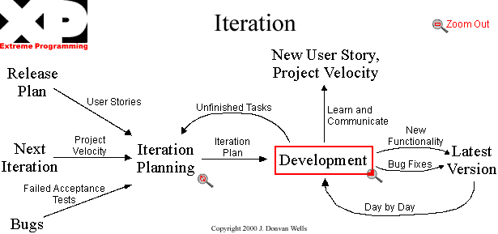
The customer selects user stories from the release plan with estimates that total up to the project velocity from the last iteration.
Failed acceptance tests to be fixed are also selected.
User stories (user’s lang) brake down into the programming task (developer’s lang)
Developers sign up to do the task and estimate how long their own tasks will take to complete in days.
Check w.r.t. the project velocity to determine if the iteration is over booked
Avoid adding any functionality before it is scheduled.

Slide 37
Extreme Programming (XP)
XP Coding
Recommends the construction of a unit test for a store before coding commences
Code the unit test first.
Encourages “pair programming”
The customer is always available.
Code must be written to agreed standards.
Only one pair integrates code at a time.
Integrate often.
Set up a dedicated integration computer.
Use collective ownership.

Slide 38
Extreme Programming (XP)
XP Testing
All code must have unit tests.
All code must pass all unit tests before it can be released.
All unit tests are executed daily
When a bug is found tests are created.
“Acceptance tests” are defined by the customer and executed to assess customer visible functionality
Acceptance tests are run often and the score is published.

Slide 39
XP Managing
Set a sustainable pace.
The Project Velocity is measured.
A stand up meeting starts each day.
Move people around.
Fix XP when it breaks.
Give the team a dedicated open work space.

Slide 42
Extreme programming practices (a)
Principle or practice | Description
Incremental planning | Requirements are recorded on story cards and the stories to be included in a release are determined by the time available and their relative priority. The developers break these stories into development ‘Tasks’.
Small releases | The minimal useful set of functionality that provides business value is developed first. Releases of the system are frequent and incrementally add functionality to the first release.
Simple design | Enough design is carried out to meet the current requirements and no more.
Test-first development | An automated unit test framework is used to write tests for a new piece of functionality before that functionality itself is implemented.
Refactoring | All developers are expected to refactor the code continuously as soon as possible code improvements are found. This keeps the code simple and maintainable.

Slide 43
Extreme programming practices (a)
Planning Game: Determine the next release’s scope by working with customers
Customer: prioritize tasks
Programmer: estimate how much a task cost
Testing: tests are written first, by both programmers and customer: unit tests, acceptance tests
Tests are your goals to achieve
Implement test first requires through understanding of the specification
Ambiguities and omissions are captured before implementation
Decide on interfaces –how modules will communicate

Slide 44
Extreme programming practices (a)
Refactoring: Restructure the system without changing its behavior
Simplicity: focus on current requirements and no more
Future may change
Maintain simplicity via frequent refactoring
Instead of upfront design; re-architect for simplicity
Example refactoring
Re-organization of a class hierarchy to remove duplicate code.
Tidying up and renaming attributes and methods to make them easier to understand.
The replacement of inline code with calls to methods that have been included in a program library.

Slide 45
Refactoring
Programming team look for possible software improvements and make these improvements even where there is no immediate need for them.
This improves the understandability of the software and so reduces the need for documentation.
Changes are easier to make because the code is well-structured and clear.
However, some changes requires architecture refactoring and this is much more expensive.

Slide 46
Extreme programming practices (b)
Pair programming | Developers work in pairs, checking each other’s work and providing the support to always do a good job.
Collective ownership | The pairs of developers work on all areas of the system, so that no islands of expertise develop and all the developers take responsibility for all of the code. Anyone can change anything.
Continuous integration | As soon as the work on a task is complete, it is integrated into the whole system. After any such integration, all the unit tests in the system must pass.
Sustainable pace | Large amounts of overtime are not considered acceptable as the net effect is often to reduce code quality and medium term productivity
On-site customer | A representative of the end-user of the system (the customer) should be available full time for the use of the XP team. In an extreme programming process, the customer is a member of the development team and is responsible for bringing system requirements to the team for implementation.

Slide 47
Extreme programming practices (b)
Pair programming: 2 programmers at 1 machine write codes
Two programmer working side-by-side, on the same computer, interchanging roles back and forth. While one programmer actively implements, the other observes and identify defects and also thinks strategically about the direction of the code
Informal reviews
Collective ownership: Anyone in the team can modify the code; Everyone is responsible of every bit of code

Slide 48
Pair programming
In XP, programmers work in pairs, sitting together to develop code.
Pairs are created dynamically so that all team members work with each other during the development process.
The sharing of knowledge: reduces the overall risks to a project when team members leave.
encourages refactoring since the whole team can benefit from it.
Pair programming is not necessarily inefficient and there is evidence that a pair working together is more efficient than 2 programmers working separately.

Slide 49
Advantages of pair programming
It supports the idea of collective ownership and responsibility for the system.
the team has collective responsibility for resolving these problems.
It acts as an informal review process because each line of code is looked at by at least two people.
It helps support refactoring, which is a process of software improvement.
Where pair programming and collective ownership are used, others benefit immediately from the refactoring so they are likely to support the process.

Slide 50
Extreme programming practices (b)
Continuous integration: Integrate and build the system many times a day
Keep testing while integrating=always a working product
40-hour a week: Work no more than 40 hours per week
On-site customer: Have the customer on the team to answer questions full-time
Resolve disputes; set short term priorities; decisions
Coding standards:
Improve communication by adopting coding standards; collective ownership;maintanance

Slide 51
Testing in XP
Testing is central to XP and XP has developed an approach where the program is tested after every change has been made.
XP testing features:
Test-first development. (write the test before writing code)
Incremental test development from scenarios.
User involvement in test development and validation.
Automated testing tools are used to run all component tests each time a new release is built.

Slide 52
Test-first development
Writing tests before code clarifies the requirements to be implemented.
Both interface and function’s behavior
Ambiguities and omissions are clarified
Tests are written as programs rather than data so that they can be executed automatically. The test includes a check that it has executed correctly.
Usually relies on a testing framework such as JUnit.
All previous and new tests are run automatically when new functionality is added, => checking that the new functionality has not introduced errors.

Slide 53
Customer involvement
The role of the customer in the testing process is to help develop acceptance tests for the stories that are to be implemented in the next release of the system.
The customer who is part of the team writes tests as development proceeds. All new code is therefore validated to ensure that it is what the customer needs.
However, people adopting the customer role have limited time available and so cannot work full-time with the development team.
They may feel that providing the requirements was enough of a contribution and so may be reluctant to get involved in the testing process.

Slide 54
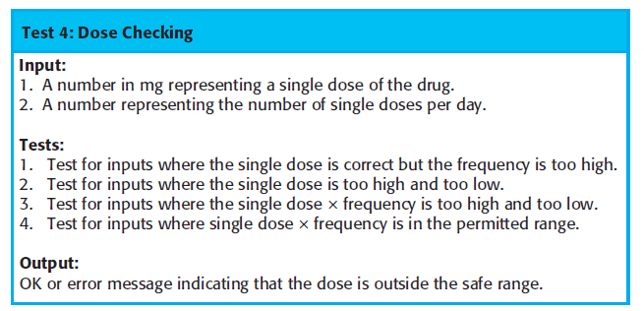
Test case description for dose checking

Slide 55
Test automation
Test automation means that tests are written as executable components before the task is implemented
These testing components should be stand-alone, should simulate the submission of input to be tested and should check that the result meets the output specification.
An automated test framework (e.g. Junit, NUnit) is a system that makes it easy to write executable tests and submit a set of tests for execution.
Since testing is automated, there is always a set of tests that can be quickly and easily executed
Whenever any functionality is added to the system, the tests can be run and problems that the new code has introduced can be caught immediately.

Slide 56
XP testing difficulties
Programmers prefer programming to testing and sometimes they take short cuts when writing tests.
E.g. they may write incomplete tests that do not check for all possible exceptions that may occur.
Some tests can be very difficult to write incrementally.
E.g., in a complex user interface, it is difficult to write unit tests for the code that implements the ‘display logic’ and workflow between screens.
difficult to judge the completeness of a set of tests.
Although you may have a lot of system tests, your test set may not provide complete coverage.
Hence: although a large set of frequently executed tests may give the impression that the system is complete and correct, this may not be the case.
Notes:
If the tests are not reviewed and further tests written after development, then undetected bugs may be delivered in the system release.

Slide 58
Agile project management
The principal responsibility of software project managers is to manage the project so that the software is delivered on time and within the planned budget for the project.
Standard approach to project management is plan-driven.
Managers draw up a plan for the project showing what should be delivered, when it should be delivered and who will work on the development of the project deliverables.
Agile project management requires a different approach,
Requirements are developed incrementally –need to adapt this
use particular strengths of agile methods.
E.g. Scrum management process

Slide 59
Scrum
The Scrum approach is a general agile method but its focus is on managing iterative development rather than specific agile practices.
Originally proposed by Schwaber and Beedle
There are three phases in Scrum.
Initial phase: an outline planning phase where you establish the general objectives for the project and design the software architecture.
Next, a series of sprint cycles where each cycle develops an increment of the system.
project closure: wraps up the project, completes required documentation such as system help frames and user manuals and assesses the lessons learned from the project.

Slide 60
Roles
Product Owner determine what needs to be built in the next 30 days or less. (a sprint)
Development Team build what is needed in 30 days (or less), and then demonstrate what they have built. Based on this demonstration, the Product Owner determines what to build next.
Scrum Master ensure this process happens as smoothly as possible, and continually help improve the process, the team and the product being created.

Slide 61
Scrum sprint cycle

Slide 62
The Sprint cycle
Sprints are fixed length, normally 2–4 weeks. They correspond to the development of a release of the system in XP.
The starting point for planning is the product backlog,
Backlog: the list of work to be done on the project.
The Product Owner is the sole person responsible for managing the Product Backlog.
Review, assign priorities and risks
Notes:
The selection phase involves all of the project team who work with the customer to select the features and functionality to be developed during the sprint.

Slide 63
Sprints
Scrum organizes work in iterations or cycles of up to a calendar month called sprints.
Key characteristics of Sprint
It is time-boxed
Have a short and consistent duration
Have a goal
Must reach the end state specificed by the team’s definition of done
©:https://innolution.com/resources/visual-agilexicon-attribution and Essential Scrum by Kenneth S. Rubin

Slide 64
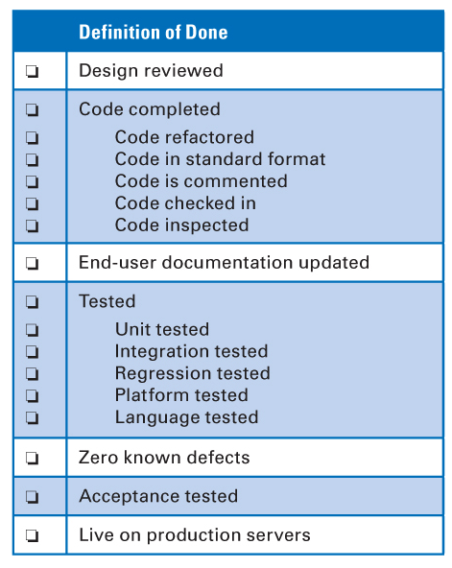
Definition of Done
It is a checklist of the types of work that the team is expected to successfully complete before it can declare its work to be potentially shippable
Definition of Done Can Evolves Over Time
A bare-minimum definition of done should yield a complete slice of product functionality, one that has been designed, built, integrated, tested, and documented and will deliver validated customer value.
©:https://innolution.com/resources/visual-agilexicon-attribution and Essential Scrum by Kenneth S. Rubin
Notes:
how the result of each sprint should be a potentially shippable product increment. I also mentioned that “potentially shippable” doesn’t mean that what was built must actually be shipped. Shipping is a business decision that often occurs at a different cadence; in some organizations it may not make sense to ship at the end of every sprint.

Slide 65
Definition of Done vs Acceptance Criteria
Each product backlog item that is brought into the sprint should have acceptance criteria (a set of conditions of satisfaction)
Acceptance criteria
1.The external quality characteristics specified by the product owner from a business or stakeholder perspective.
Acceptance criteria define desired behavior and are used to determine whether a product backlog item has been successfully developed.
2. The exit criteria that a component or a system must satisfy in order to be accepted by a user, customer, or other authorized entity
The product owner is responsible for defining the acceptance criteria for each product backlog item
©:https://innolution.com/resources/visual-agilexicon-attribution and Essential Scrum by Kenneth S. Rubin

Slide 66
Definition of Done vs Acceptance Criteria
Each product backlog item that is brought into the sprint should have acceptance criteria (a set of conditions of satisfaction)
Product Backlog Items that passess the acceptance criteria are moved to «Done» state.
Example
PB Item: Allow a customer to purchase with a credit card
Acceptance Criteria: Works with AmEx, Visa, and MasterCard
©:https://innolution.com/resources/visual-agilexicon-attribution and Essential Scrum by Kenneth S. Rubin

Slide 67
Sprint Goal
Once the sprint goal has been established and sprint execution has begun, no change is permitted that can materially affect the sprint goal.
Sprint goal has a clear, single focus:
Support initial report generation.
Load and curate Ankara map data.
The sprint goal is the foundation of a mutual commitment made by the team and the product owner.
Curtesy of Özden Ö. Top

Slide 68
Change vs Clarification
Although the sprint goal should not be materially changed, it is permissible to clarify the goal.
Change:
Adding a new item
Removing an item
Significantly altering the scope of a backlog item
Product owner: “Oh, when I said that we need to be able to search the police database for an offender, I didn’t just mean by last name and first name. I also meant we should be able to search the database based on a picture of the suspect’s body tattoos!”
Curtesy of Özden Ö. Top

Slide 69
Scrum in a nutshell
A product owner creates a prioritized wish list: Product backlog.
Sprint: 1 month iteration (small project)
During each sprint, the team begins with sprint planning : selecting tasks from the product backlog to produce the sprint backlog , which is a plan for the sprint.
Planning: max 8 hour
What can be delivered in the Increment resulting from the upcoming Sprint?
How will the work needed to deliver the Increment be achieved?

Slide 70
Scrum in a nutshell -development
After selection, the team organize themselves for development
daily Scrum meetings to coordinate and to ensure that they are producing the best possible product increment. --assess the progress
Daily Scrum : 15-minute time-boxed event for the Development Team to synchronize activities and create a plan for the next 24 hours
What did I do yesterday that helped the Dev. Team meet the Goal?
What will I do today to help the Development Team meet the Goal?
Do I see any impediment that prevents me or the Development Team from meeting the Sprint Goal?

Slide 71
Cont’d
Along the way, the ScrumMaster keeps the team focused on its goal.
During this stage the team is isolated from the customer and the organization; all communications channelled through ‘Scrum master’.
to protect the development team from external distractions.
The sprint ends with a sprint review and retrospective.
At the end of the sprint, the work done is reviewed and presented to stakeholders.
At the end of the sprint, the work should be potentially shippable: ready to hand to a customer, put on a store shelf, or show to a stakeholder.
The next sprint cycle begins immediately after this sprint.

Slide 72
Teamwork in Scrum
The ‘Scrum master’ is a facilitator who
arranges daily meetings,
records decisions,
measures progress against the backlog
and communicates with customers and management outside of the team.
The whole team attends short daily meetings
all team members share information,
describe their progress since the last meeting, problems that have arisen and what is planned for the following day.
This means that everyone on the team knows what is going on and, if problems arise, can re-plan short-term work to cope with them.

Slide 73
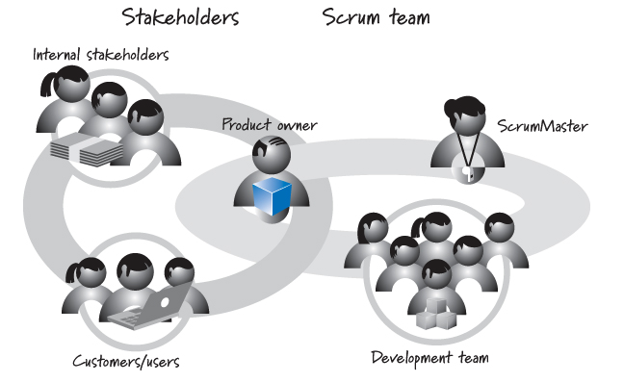
Scrum Roles: Product Owner
The product owner is the empowered central point of product leadership.
©:https://innolution.com/resources/visual-agilexicon-attribution and Essential Scrum by Kenneth S. Rubin
Notes:
On one hand, the product owner must understand the needs and priorities of the organizational stakeholders, the customers, and the users well enough to act as their voice. In this respect the product owner acts as a product manager, ensuring that the right solution is developed.
On the other hand, the product owner must communicate to the development team what to build and the order in which to build it. The product owner must also ensure that the criteria for accepting features are specified and the tests that verify those criteria are later run to determine whether the features are complete.

Slide 74
Product Owner
The Product Owner is the sole person responsible for managing the Product Backlog.
Product Backlog management includes:
Clearly expressing Product Backlog items;
Ordering the items in the Product Backlog to best achieve goals and missions;
Optimizing the value of the work the Development Team performs;
Ensuring that the Product Backlog is visible, transparent, and clear to all, and shows what the Scrum Team will work on next; and,
Ensuring the Development Team understands items in the Product Backlog to the level needed.

Slide 75
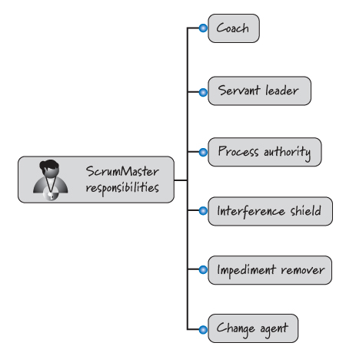
Scrum Roles – Scrum Master
the ScrumMaster is focused on helping everyone understand and embrace the Scrum values, principles, and practices.
©:https://innolution.com/resources/visual-agilexicon-attribution and Essential Scrum by Kenneth S. Rubin

Slide 76
ScrumMaster – the coach
The ScrumMaster is the agile coach for both the development team and the product owner
Observes how the team is using Scrum and does anything possible to help it get to the next level of performance
provides assistance to product owner with ongoing assistance for activities such as grooming the product backlog.
It is not like a functional manager or a project manager type role.
the ScrumMaster doesn’t hire and fire and cannot dictate to the team what tasks it should do or how to do them.
©:https://innolution.com/resources/visual-agilexicon-attribution and Essential Scrum by Kenneth S. Rubin

Slide 77
ScrumMaster -- Process Authority
Listens team members and find solutions to improve Scrum process
Ensures that the team adheres to the Scrum values, principles, and practices along with the Scrum team’s specific approaches
©:https://innolution.com/resources/visual-agilexicon-attribution and Essential Scrum by Kenneth S. Rubin

Slide 78
ScrumMaster -- Interference Shield
The ScrumMaster protects the development team from outside interference so that it can remain focused on delivering business value every sprint.
Interference can come from any number of sources, from managers who want to redirect team members in the middle of a sprint, to issues originating from other teams.
The ScrumMaster also takes responsibility for removing impediments that inhibit the team’s productivity
©:https://innolution.com/resources/visual-agilexicon-attribution and Essential Scrum by Kenneth S. Rubin

Slide 79
Development Teams
They are self-organizing. No one (not even the Scrum Master) tells the Development Team how to turn Product Backlog into Increments of potentially releasable functionality;
Development Teams are cross-functional, with all of the skills as a team necessary to create a product Increment;
The development team’s members, collectively, have the skills required to deliver the business value requested by the product owner

Slide 80
Development Teams (cont’d)
Scrum recognizes no titles for Development Team members other than Developer, regardless of the work being performed by the person; there are no exceptions to this rule;
Scrum recognizes no sub-teams in the Development Team, regardless of particular domains that need to be addressed like testing or business analysis; there are no exceptions to this rule; and,
Individual Development Team members may have specialized skills and areas of focus, but accountability belongs to the Development Team as a whole.

Slide 81

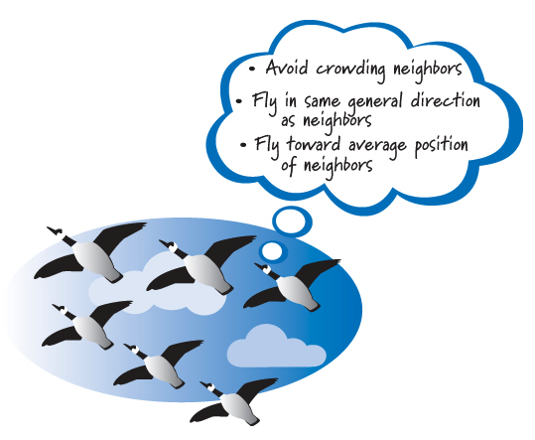
Self Organising
There is no project manager or other manager who tells the team how to do its work
there is no external dominating force applying traditional top-down, command-and-control management.
©:https://innolution.com/resources/visual-agilexicon-attribution and Essential Scrum by Kenneth S. Rubin

Slide 82
Scrum benefits
The product is broken down into a set of manageable and understandable chunks.
Unstable requirements do not hold up progress.
The whole team have visibility of everything and consequently team communication is improved.
Customers see on-time delivery of increments and gain feedback on how the product works.
Trust between customers and developers is established and a positive culture is created in which everyone expects the project to succeed.

